Slide 1
Sustainability Report 2019
Presented by You Exec

Slide 2
Our company offers more than 500 brands and 4,100 products to people in more than 200 countries and territories.
As a company, we make everyday moments more enjoyable, create opportunities for the people and communities we call home. We believe in doing business the right way, not the easy way. For us, that means continuously working to reduce our environmental impact through programs to provide access to clean drinking water, support women’s economic empowerment, and strengthen local communities.
Our Company at a Glance
55
28M
60K
51
Business Partners
Net Revenue in 2019
Total Employees
Offices & Plants
Our business partners are our biggest allies and always support our initiatives
We’d like to use our revenue as an investment back into our environment
Our employees are educated about and supportive of our initiatives.
All of our offices and plants adhere to the most up-to-date green initiatives

Slide 3
Our company offers more than 500 brands and 4,100 products to people in more than 200 countries and territories.
As a company, we make everyday moments more enjoyable, create opportunities for the people and communities we call home. We believe in doing business the right way, not the easy way. For us, that means continuously working to reduce our environmental impact through programs to provide access to clean drinking water, support women’s economic empowerment, and strengthen local communities.
Our Company at a Glance
55
28M
60K
51
Business Partners
Net Revenue in 2019
Total Employees
Offices & Plants
Our business partners are our biggest allies and always support our initiatives
We’d like to use our revenue as an investment back into our environment
Our employees are educated about and supportive of our initiatives.
All of our offices and plants adhere to the most up-to-date green initiatives

Slide 4
Our company offers more than 500 brands and 4,100 products to people in more than 200 countries and territories.
As a company, we make everyday moments more enjoyable, create opportunities for the people and communities we call home. We believe in doing business the right way, not the easy way. For us, that means continuously working to reduce our environmental impact through programs to provide access to clean drinking water, support women’s economic empowerment, and strengthen local communities.
Our Company at a Glance
55
28M
60K
51
Business Partners
Net Revenue in 2019
Total Employees
Offices & Plants
Our business partners are our biggest allies and always support our initiatives
We’d like to use our revenue as an investment back into our environment
Our employees are educated about and supportive of our initiatives.
All of our offices and plants adhere to the most up-to-date green initiatives

Slide 5
Our company offers more than 500 brands and 4,100 products to people in more than 200 countries and territories.
As a company, we make everyday moments more enjoyable, create opportunities for the people and communities we call home. We believe in doing business the right way, not the easy way. For us, that means continuously working to reduce our environmental impact through programs to provide access to clean drinking water, support women’s economic empowerment, and strengthen local communities.
Our Company at a Glance
55
28M
60K
51
Business Partners
Net Revenue in 2019
Total Employees
Offices & Plants
Our business partners are our biggest allies and always support our initiatives
We’d like to use our revenue as an investment back into our environment
Our employees are educated about and supportive of our initiatives.
All of our office and plants adhere to the most up-to-date green initiatives

Slide 6
Financial Performance
2019 Sustainability Highlights
Year-to-year Financials
Our Ambitions & Goals
Business Overview
Sustainability
Professional Excellence
Environmental Experience
Sustainability Appendix

Slide 7
+40%
Organic Revenue Growth
+80%
Operating Income Growth
The growth rate we can achieve by increasing output and enhancing sales internally. This does not include profits or growth attributable to takeovers, acquisitions or mergers.
This shows how much of our company’s revenue will become profits. Operating income is similar to EBIT and is also referred to as our operating profit or recurring profit.
FY 2017
FY 2017
FY 2018
FY 2018
FY 2019
FY 2019
+60%
Diluted Earnings Per Share
+25%
Free Cash Flow
Our EPS calculated as net income divided by the number of common shares if all warrants and stock options were exercised and all convertible bonds and preferred stock were converted.
The cash we produce through our operations, less the cost of expenditures on assets. FCF is the cash left over after we paid for operating expenses and capital expenditures (CAPEX).
FY 2017
FY 2017
FY 2018
FY 2018
FY 2019
FY 2019

Slide 8
2019 Sustainability Highlights
We strive to become an ever more sustainable company by maximizing the positive impact we have on all our stakeholder groups while minimizing our negative impact throughout the value chain. We seek to be characterized by our passion, integrity, entrepreneurialism and innovative spirit, as we fulfil our vision.
22%
100%
80%
28
77%
Budget increase for environmental causes
Of employees covered by human rights assessments
With our increase in revenue, our company has been able to allocate more funding to environmental causes.
As was the case in the previous years, we ensure all employees are respected and feel safe at work.
Of our new products are environmentally friendly
New sustainability related patents filed
Employee participation in environmental initiatives
Our scientists and product team made the most use of this funding to ensure our products adhere to our goals.
Our new patent pending technologies will result in more revenue but also allow us to give back to the community.
All new hires are now required to participate in eco initiatives and have been introduced to them during their onboarding.

Slide 9
Year-to-Year Financials
2017
2018
2019
Summary of Operations
Net operating revenues |  |  | $ 40,000 | $ 35,900 | $ 31,876
Net income from continuing operation |  |  | 6,650 | 1,182 | 6,800
Net income attributable |  |  | 6,500 | 1,234 | 6,450
Per Share Data
Basic net income from continuing operations |  |  | $ 1.51 | $ 0,28 | $ 1.58
Diluted net income from continuing operations |  |  | 1.51 | 0.29 | 1.51
Cash dividends |  |  | 1.49 | 0.27 | 1.57
Balance Sheet Data
Total Assets |  |  | $ 87,000 | $ 86,400 | $ 84,545
Long Term debt |  |  | 29,000 | 31,500 | 25,789

Slide 10
Our Ambitions & Goals
Workplace
Product
Environmental Contribution
Focus | Health & Safety | Human Rights | Employee Engagement | Sustainable Technology | Climate Change | Water Impact | Reduce & Recycle
Ambition | Be a safe workplace with zero injuries and hazards. | Be recognized as a leader in labour and human rights. | Offer the best experience in all operating locations | Make products with the greatest positive impact for society. | Reduce our carbon footprint as well as GHG emissions. | Maintain our leadership in water efficiency. | Strive for zero waste in landfill and zero hazardous materials.
2020 Goals | <0.1% For employees and contractors | 100% Recognized by external bodies | +10 experiences every quarter | 10% Reduction in product pricing | 20% Less energy consumption | 20% Less unnecessary water consumption | 90% Of waste reused or recycled

Slide 11
Business Overview
Sustainability Governance
Sustainability Strategy
Sustainability Leadership Model
Sustainability Pillars
Core Sustainability Programs
Sustainability
Professional Excellence
Environmental Experience
Sustainability Appendix

Slide 12
Sustainable Governance
The Sustainability Committee supports the Operations Council and meets to develop sustainability strategy, review our sustainability management performance and approach, and agree on core programs and targets.
The Sustainability Committee is comprised of our Chief Operating Officers, Executive Vice Presidents and Senior Vice Presidents, who represent the full breadth of the Group in terms of regions, functions and services.
James Lake
Gracie May
Rob Greene
Insert description of duties here
Insert description of duties here
Insert description of duties here
Lily Kaplan
Daniel Hills
Rosie Ponds
Insert description of duties here
Insert description of duties here
Insert description of duties here

Slide 13
Our Approach
We believe that there is an opportunity to change how the world produces, distributes, consumes and disposes of foods and beverages in order to tackle the shared challenges we face.
Our Sustainability Strategy
climate change mitigation
Our Shared Challenges
The global system brings economic opportunity, convenience, and enjoyment to more people, but it faces pressures that threaten its future ability to meet the needs of a growing global population.
Next Generation Agriculture
Positive water impact
Choice improvement
Future of product packaging
Our Priorities
We recognize Next Generation Agriculture, Improved choices across our portfolio, positive water impact, people and prosperity as the priorities to devote our resources into right now.
people and prosperity

Slide 14
Our Approach
We believe that there is an opportunity to change how the world produces, distributes, consumes and disposes of foods and beverages in order to tackle the shared challenges we face.
Our Sustainability Strategy
climate change mitigation
Our Shared Challenges
The global system brings economic opportunity, convenience, and enjoyment to more people, but it faces pressures that threaten its future ability to meet the needs of a growing global population.
Next Generation Agriculture
Positive water impact
Choice improvement
Future of product packaging
Our Priorities
We recognize Next Generation Agriculture, Improved choices across our portfolio, positive water impact, people and prosperity as the priorities to devote our resources into right now.
people and prosperity

Slide 15
Our Approach
We believe that there is an opportunity to change how the world produces, distributes, consumes and disposes of foods and beverages in order to tackle the shared challenges we face.
Our Sustainability Strategy
climate change mitigation
Our Shared Challenges
The global system brings economic opportunity, convenience, and enjoyment to more people, but it faces pressures that threaten its future ability to meet the needs of a growing global population.
Next Generation Agriculture
Positive water impact
Choice improvement
Future of product packaging
Our Priorities
We recognize Next Generation Agriculture, Improved choices across our portfolio, positive water impact, people and prosperity as the priorities to devote our resources into right now.
people and prosperity

Slide 16
Sustainability Leadership Model
Impact Valuation
We analyse our performance using different techniques, so not to only driven by positive financial growth but also positive impact on the community.
Value to Society
Our business activity is designed to create value for and through our main stakeholders, which includes investors, customers, governments and industries.
6
1
Leading Service
We set examples to encourage and enable our customers to make better choices and leads a more productive and sustainable life.
Global Drivers
We closely monitor and respond to market and society needs and prefer to address those needs prior to them surfacing at a large scale if possible.
5
Leadership Model
2
Business Model
We believe that can ultimately drive better and consistent business growth even though we’re financial investing more resources into such initiatives.
Integrated Leadership
Many members of our leadership team have participated in our business operations and understands how sustainability may be best combined with day-to-day business operations.
4
3

Slide 17
Professional Excellence
1
Our responsibility to maintain the highest levels of operational excellence, professional integrity and best-in-class quality strengthens our position as a global market.
People
2
We empower our employees to succeed in a safe, diverse and inclusive workplace that treats everyone fairly and with respect.
Our Sustainability Pillars
Environment
3
We follow a carbon neutrality strategy, seek to use resources efficiently and work to deliver sustainable value.
Community
4
We welcome local talent and engender a company culture of giving back through projects that are aligned with the SDG.

Slide 18
Professional Excellence
1
Our responsibility to maintain the highest levels of operational excellence, professional integrity and best-in-class quality strengthens our position as a global market.
People
2
We empower our employees to succeed in a safe, diverse and inclusive workplace that treats everyone fairly and with respect.
Our Sustainability Pillars
Environment
3
We follow a carbon neutrality strategy, seek to use resources efficiently and work to deliver sustainable value.
Community
4
We welcome local talent and engender a company culture of giving back through projects that are aligned with the SDG.

Slide 19
Professional Excellence
1
Our responsibility to maintain the highest levels of operational excellence, professional integrity and best-in-class quality strengthens our position as a global market.
People
2
We empower our employees to succeed in a safe, diverse and inclusive workplace that treats everyone fairly and with respect.
Our Sustainability Pillars
Environment
3
We follow a carbon neutrality strategy, seek to use resources efficiently and work to deliver sustainable value.
Community
4
We welcome local talent and engender a company culture of giving back through projects that are aligned with the SDG.

Slide 20
Professional Excellence
1
Our responsibility to maintain the highest levels of operational excellence, professional integrity and best-in-class quality strengthens our position as a global market.
People
2
We empower our employees to succeed in a safe, diverse and inclusive workplace that treats everyone fairly and with respect.
Our Sustainability Pillars
Environment
3
We follow a carbon neutrality strategy, seek to use resources efficiently and work to deliver sustainable value.
Community
4
We welcome local talent and engender a company culture of giving back through projects that are aligned with the SDG.

Slide 21
Core Sustainability Programs
Lead by corporate sustainability
Value to society measurement
Human rights protection
Energy efficiency program
Sustainable procurement strategy
Sustainability training
Sustainability risk management
Human rights awareness
Sustainable mobility strategy
Social projects through our Academy
Women in leadership
Carbon neutrality
Employee satisfaction: Catalyst
Employee volunteering
In partnership with other functions

Slide 22
Business Overview
Sustainability
Human Rights
Compliance Breakdown
Diversity & Inclusion
Women Empowerment
Professional Excellence
Environmental Experience
Sustainability Appendix

Slide 23
Economic risks
Risk category A
Risk category B
Risk category C
Human Rights
Our programs are established to ensure that all of our employees are treated with respect and dignity. By leading by example in this space and driving our requirements down our supply chain, we can positively influence others to do the same, adding value to communities, employees, suppliers and society.
We have worked to identify, map and prioritize potential human rights risks across our value chain. Our vast supply chain is where many of the identified human rights risks may occur. Other issues, such as working conditions in the informal recycling sector, may be present in certain geographies and require partnership with organizations in the private and public sectors and civil society to address in a systemic way.
Social risks
Risk category A
Risk category B
Risk category C
Environment risks
Risk category A
Risk category B
Risk category C

Slide 24
Labor & Human Rights Non-Compliance Breakdown
Health & Safety Non-Compliance Breakdown

Slide 25
>20%
>200
90%
Diversity & Inclusion
Minority in all management levels
Women participated in Lead ship programs
Employees believe their workplace is diverse
As a global business, our ability to understand, embrace and operate in a diverse world—both in the marketplace and in the workplace—is critical to our long-term sustainability and to doing business the right way.
By building an inclusive workplace environment, we seek to leverage the talent, insights and ideas of our global employees. Our aspiration is not only to mirror, at every level of leadership, the diversity of the communities we operate, but also to exceed industry norms. We share diversity and inclusion metrics across our global workforce with our board of directors and senior leaders on a quarterly basis, highlighting progress and driving accountability.
85%
Feel belonged and accepted
95%
Feel more comfortable and creative
75%
Feel happier and more likely to stay

Slide 26
Women Empowerment
Women invest a sizable portion of the income they earn into their local economies, creating a tremendous economic impact. From fruit farmers to artisans to small retailers and distributors, we’re helping women overcome business barriers.
In 2015, The Company made a commitment to economically empower 5 million women by 2020 through our initiative. We partner with governments and NGOs to address specific barriers to business success that women entrepreneurs face. These programs meet women where they are—in their communities, businesses and online—and provide enabling activities that include: business skills training, financial services and/or assets, and peer-to- peer mentoring networks.
1.4M
2M
95K
20K
Received business skills training
Received pro bono financial services
Joined our women mentoring network
Received direct job placement

Slide 27
Business Overview
Sustainability
Professional Excellence
Greenhouse Gas Emission
Water Impact
Agriculture
Environment Indicators
Environmental Experience
Sustainability Appendix

Slide 28
Greenhouse Gas Emissions vs. Production Growth
As our production volume has consistently increased over the past five years, our Scope 1 and 2 GHG emissions have gone down. We track our emissions per litre of product sold at a system level, expressed as a ratio (grams of CO2 in relation to litres of product produced).
40%
35%
Production Growth
Production Growth
20%
25%
7%
Production Growth
20%
Production Growth
Emissions
15%
Emissions
10%
Emissions
Emissions
2017
2016
2018
2019

Slide 29
Water Impact
77%
23%
In 2019, we improved our water efficiency and achieved a 5% reduction in our water consumption per unit of production compared to 2018 – reaching our lowest level ever. During the year, we recycled 41% of our water, reusing it for a variety of different purposes, such as scrubbers and cooling towers.
Municipal Water
Ground Water
We introduced our water conservation strategy in 1994 to help us improve water efficiency through water saving programs and recycling projects, contributing to SDG targets 6.4 and 8.4.
700K
65%
$2M
Lives transformed by water
Reduction in water used in our plants
Invested in water sanitation projects

Slide 30
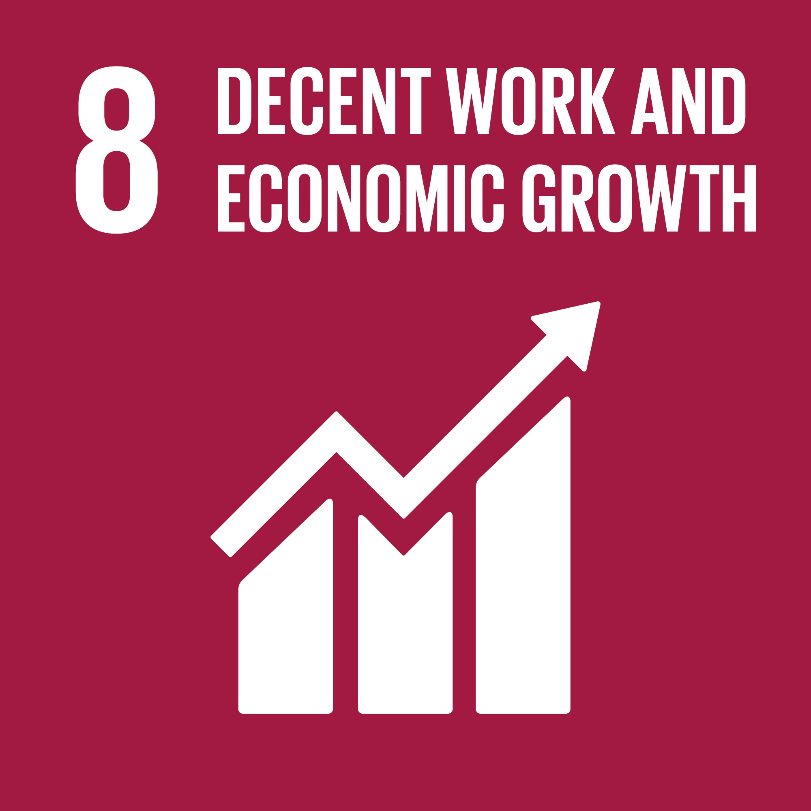
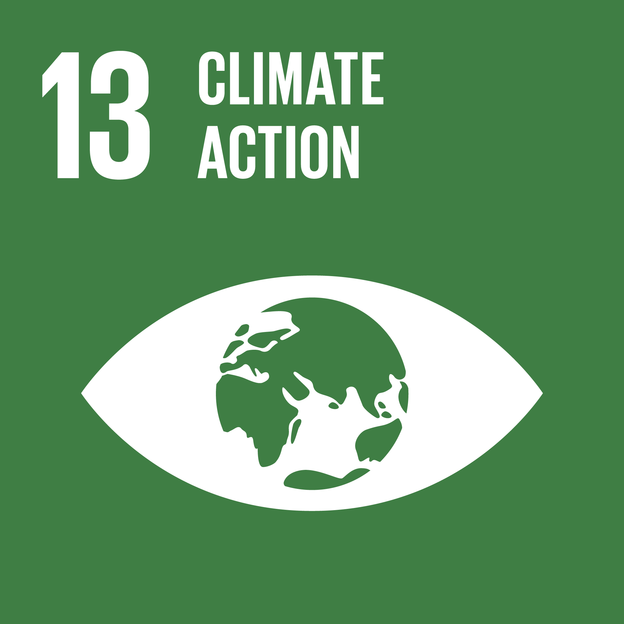
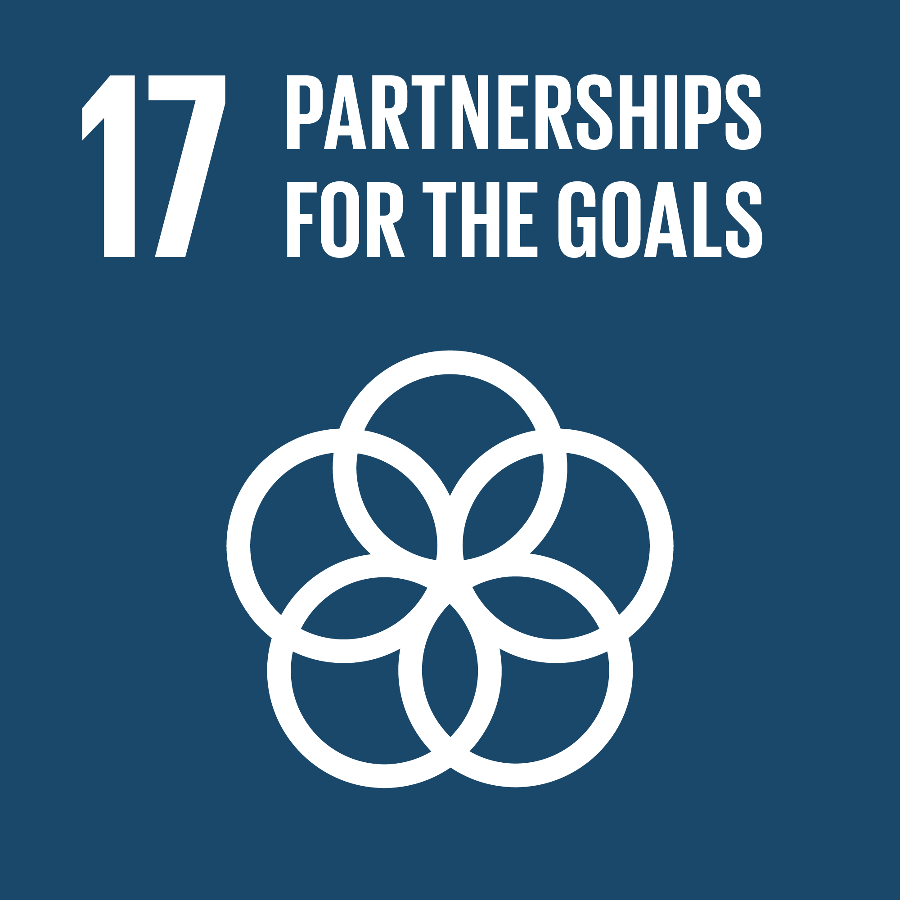
Agriculture
Ingredients are at the heart of our products, and our transformation into a total beverage company is also expanding the variety of ingredients we use. We source a wide range of agricultural commodities—including fruit juices, coffee, tea, sugar and soy, as well as special ingredients such as herbs and dairy-based ingredients— from a complex supply chain that spans the globe.
We have worked with our suppliers to help them demonstrate that they meet the SAGP criteria by using the leading global sustainable agriculture standards for the commodities and products they provide to our company.
A
B
C
D
E
F
G
Percentage of ingredients more sustainably sourced in 2019

Slide 31
Environment Indicators
Environmental burden – net value (SGD 3.9-6.3)
2017
2018
2019
Emission to air
Global Warming | 415960 | 397832 | 382909
Ozone Depletion | 0.00 | 0.25 | 0.14
Atmospheric Acidification (Kg) | 45610 | 34170 | 32283
Oxidant Creation | 16946 | 31498 | 46186
Air Emission | 2598 | 2063 | 2529
Emission to water
Eutrophication (kg (P+N)) | 261463 | 259428 | 160155
Aquatic Oxygen | 452987 | 474234 | 508345
Heavy Metals | 5710 | 6022 | 8217
Aquatic Ecotoxicity | 4767 | 4067 | 5114
Water withdrawal by source (1000 m3)
2017
2018
2019
Ground Water | 2600 | 3055 | 4236
Municipal Water Supplies | 14900 | 15000 | 13967
Total Withdrawal | 17500 | 18055 | 18213

Slide 32
Business Overview
Sustainability
Professional Excellence
Environmental Experience
Risk & Opportunities
2020 Sustainability Goals
Business Materiality Assessment
Stakeholder Engagement
Sustainable Development Goals
GRI Content Index
Appendix

Slide 33
Risk and Opportunities
This is a business opportunity that also also risks. There is a growing concern among consumers, public health professionals, and government agencies about the increased prevalence of certain issues that produce long lasting effects on health and safety.
Changes in local regulations to discourage the use of plastic and the cost of material inefficiencies of linear production models constitute risks across our global operations.
Product Innovation
Plastic Waste
There are many threats to water quality and availability, including unsustainable agriculture practices, poor sanitation infrastructure, industrial pollution, and industry overusing of water resources.
There is growing concern that an increase in global average temperatures and the resulting changes to the climate will cause significant disruptions in weather patterns around the globe, creating more frequent and severe natural disasters.
Water Resource
Climate Change

Slide 34
2020 Sustainability Goals
We aim to achieve our goals through a concerted effort by the Company and nearly 100 partners in more than 75+ countries and territories. We have set ambitious goals to drive system-wide change beyond standard operational improvements.
Carbon Footprint
Women Empowerment
Water Impact
Water Impact
2018
2019
2020
2018
2019
2020
2018
2019
2020
2018
2019
2020
25%
Estimated reduction of carbon footprint
5M
Number of women financially empowered
98%
Of water returned to nature and communities
25%
Improvement in water efficiency since 2018

Slide 35
2020 Sustainability Goals (Cont.)
We aim to achieve our goals through a concerted effort by the Company and nearly 100 partners in more than 75+ countries and territories. We have set ambitious goals to drive system-wide change beyond standard operational improvements.
Health & Safety
Recycle & Waste
Human Rights
Human Rights
2018
2019
2020
2018
2019
2020
2018
2019
2020
2018
2019
2020
14%
More ingredients sustainably sourced
93%
Waste is recovered, re-used or sent for recycling
95%
Partners compliant with Supplier Guiding Principles
100%
Employees fully pass anti-harassment assessment

Slide 36
Business Materiality Assessment
We identified 28 industry-specific topics for prioritization, based on industry research, a benchmarking analysis of competitors and peers, and stakeholder input.
Year-round engagement with diverse stakeholders informs our sustainability reporting and overarching sustainability strategy. We publicly report on topics that are priorities for both our business and our key stakeholders.
The Materiality Assessment is a tool for us to identify and assess potential Environmental, Social and Governance (ESG) issues that could impact the business and its stakeholders. The assessment allows us to inform company strategy, targets and reporting. Our list of Global Reporting Initiative Material Topics represents the issues that we plan to continue managing, measuring and reporting on.
Identification
We prioritized the 28 industry- specific topics based on feedback from key internal and external stakeholders through interviews, surveys and review of source materials.
Prioritization
We narrowed the list to 17 topics specific to our business. We validated the results in a workshop with members of our sustainability leadership.
Validation

Slide 37
Stakeholder Engagement
Stakeholders
Why We Engage
How We Engage
Employees & Suppliers | As a service company, our people are essential to our business. At the same time, we rely on our suppliers to support us in the smooth delivery of our services. Our supplier relationships are mutually beneficial. | Global employee engagement program Annual integrity training Sustainability learning Supplier Self-Assessment, audits
Customers | Our customers are at the heart of everything we do. We continually aim to provide them with services that help make their businesses more efficient, profitable and sustainable. | One-to-one meetings Conferences, seminars, webinars Customer surveys
Governments & Industries | Our scale and leadership in the industry, we shape the markets in which we operate. | White papers Governments and Institutions business line Membership meetings orevents

Slide 38
Materiality Matrix
High
Governance
Climate change
Safety
This list of 17 material topics specific to our business includes issues that we intend to manage, measure and report on. These what our stakeholder are most interested in understanding.
Risk management
Human rights
Diversity
Importance to stakeholders
Water & recycle
Environment
Sustainable Profit
Engagement
Professional Governance
Energy & chemicals
Innovation
People & Safety
Business Impact
High

Slide 39
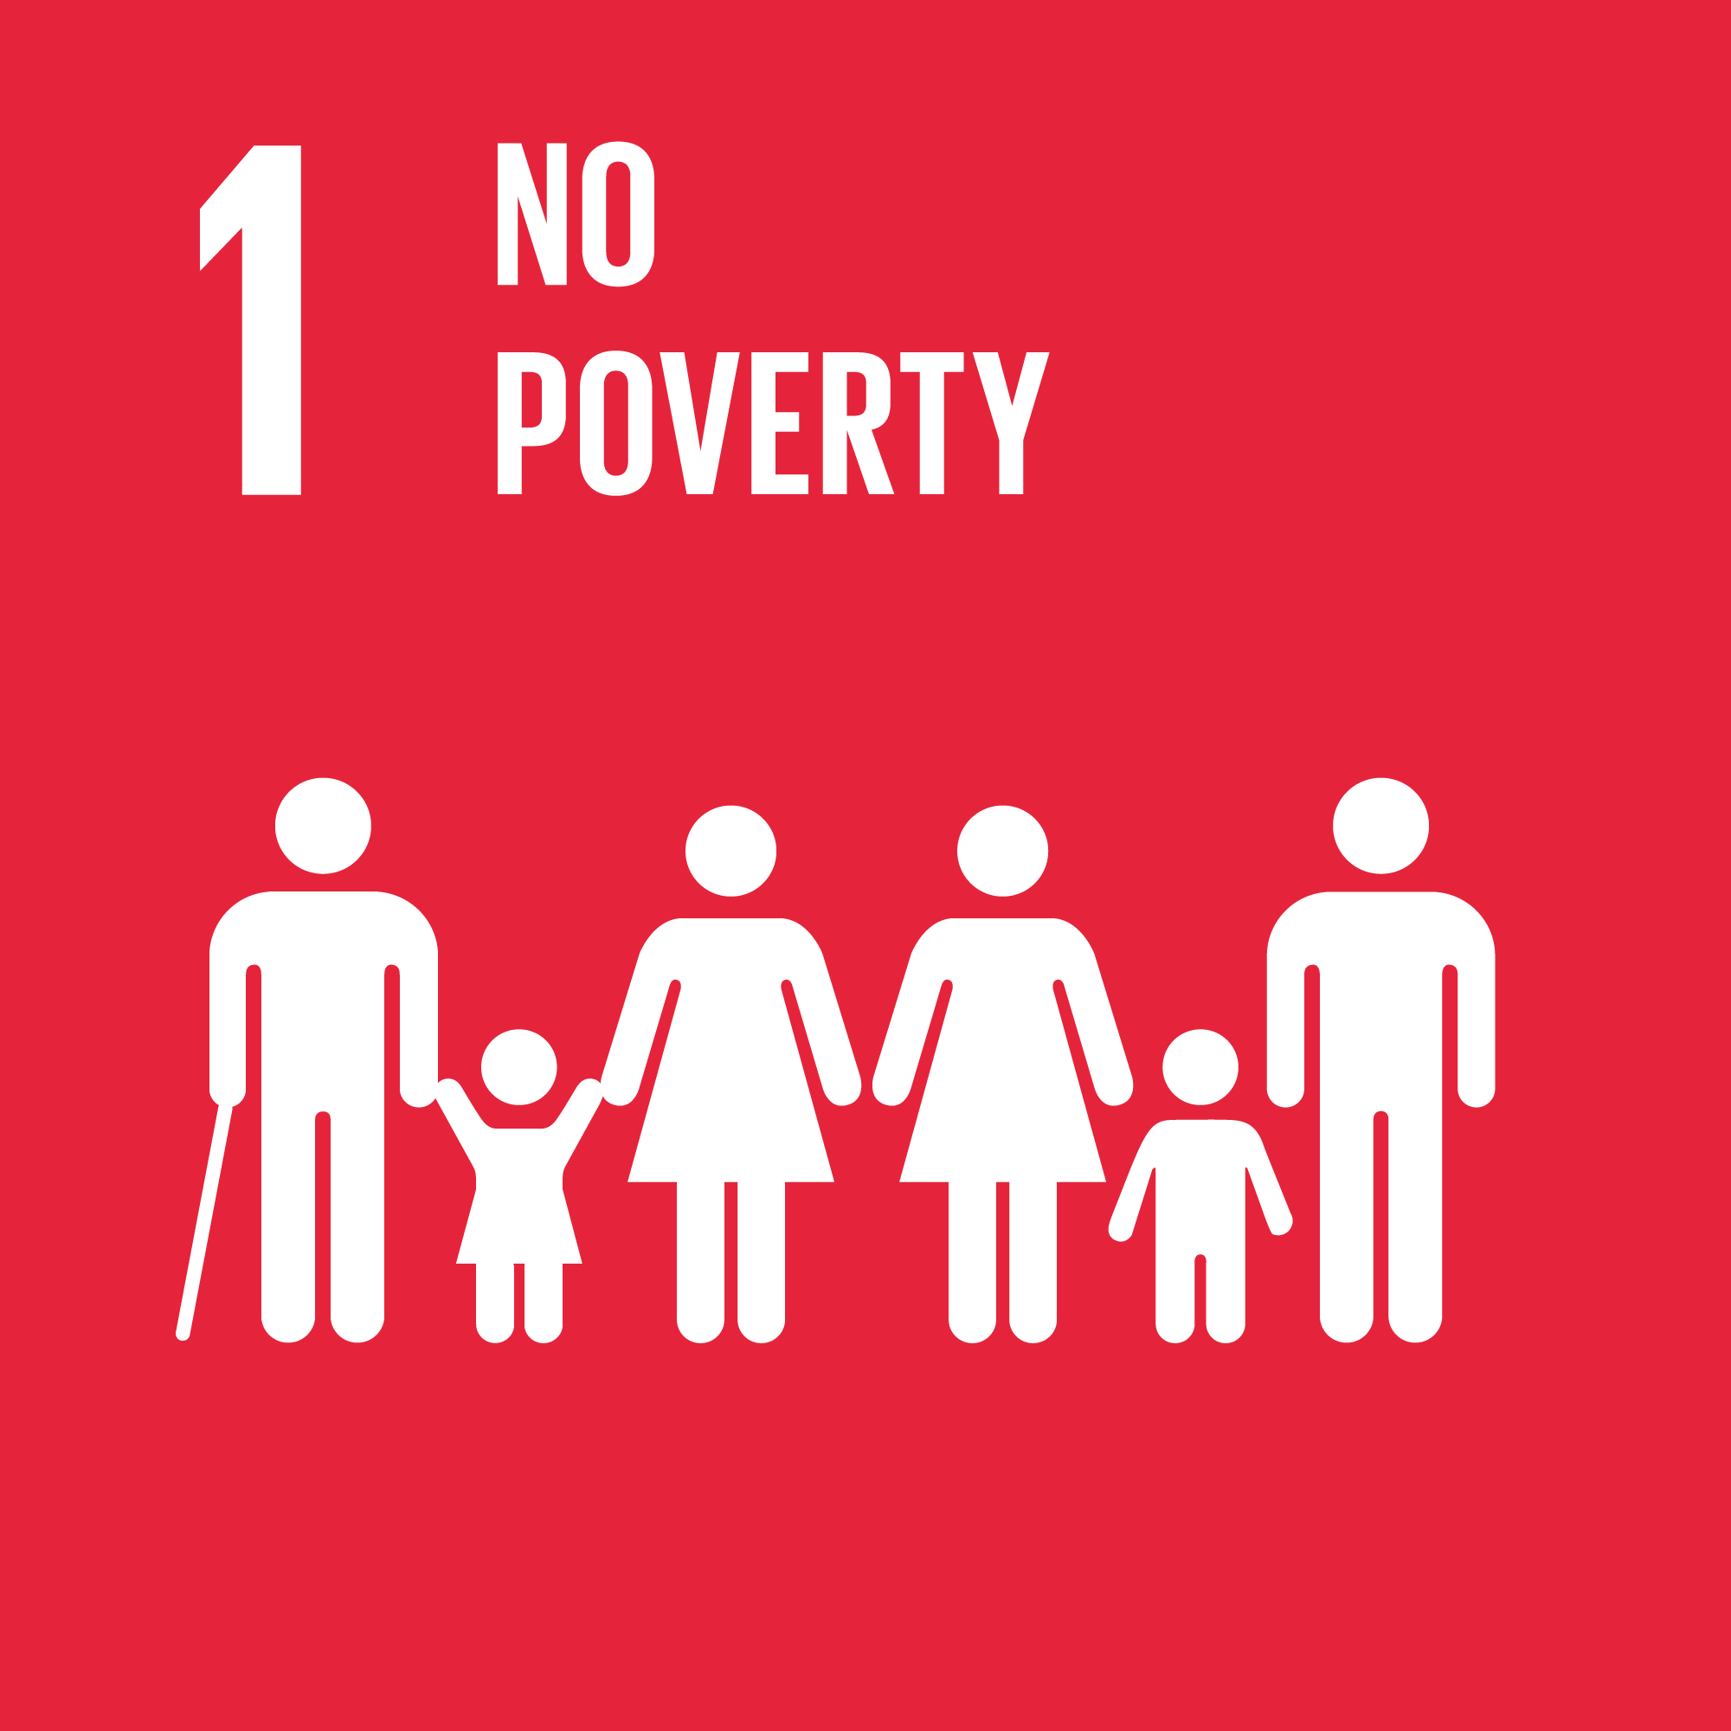
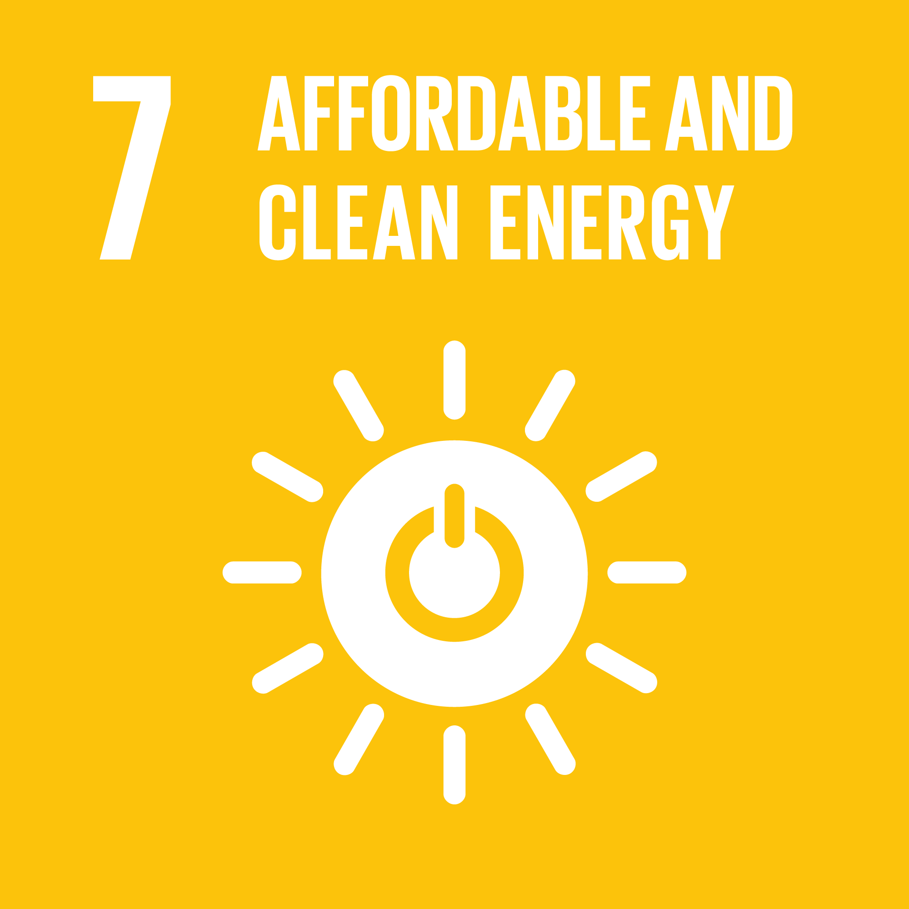
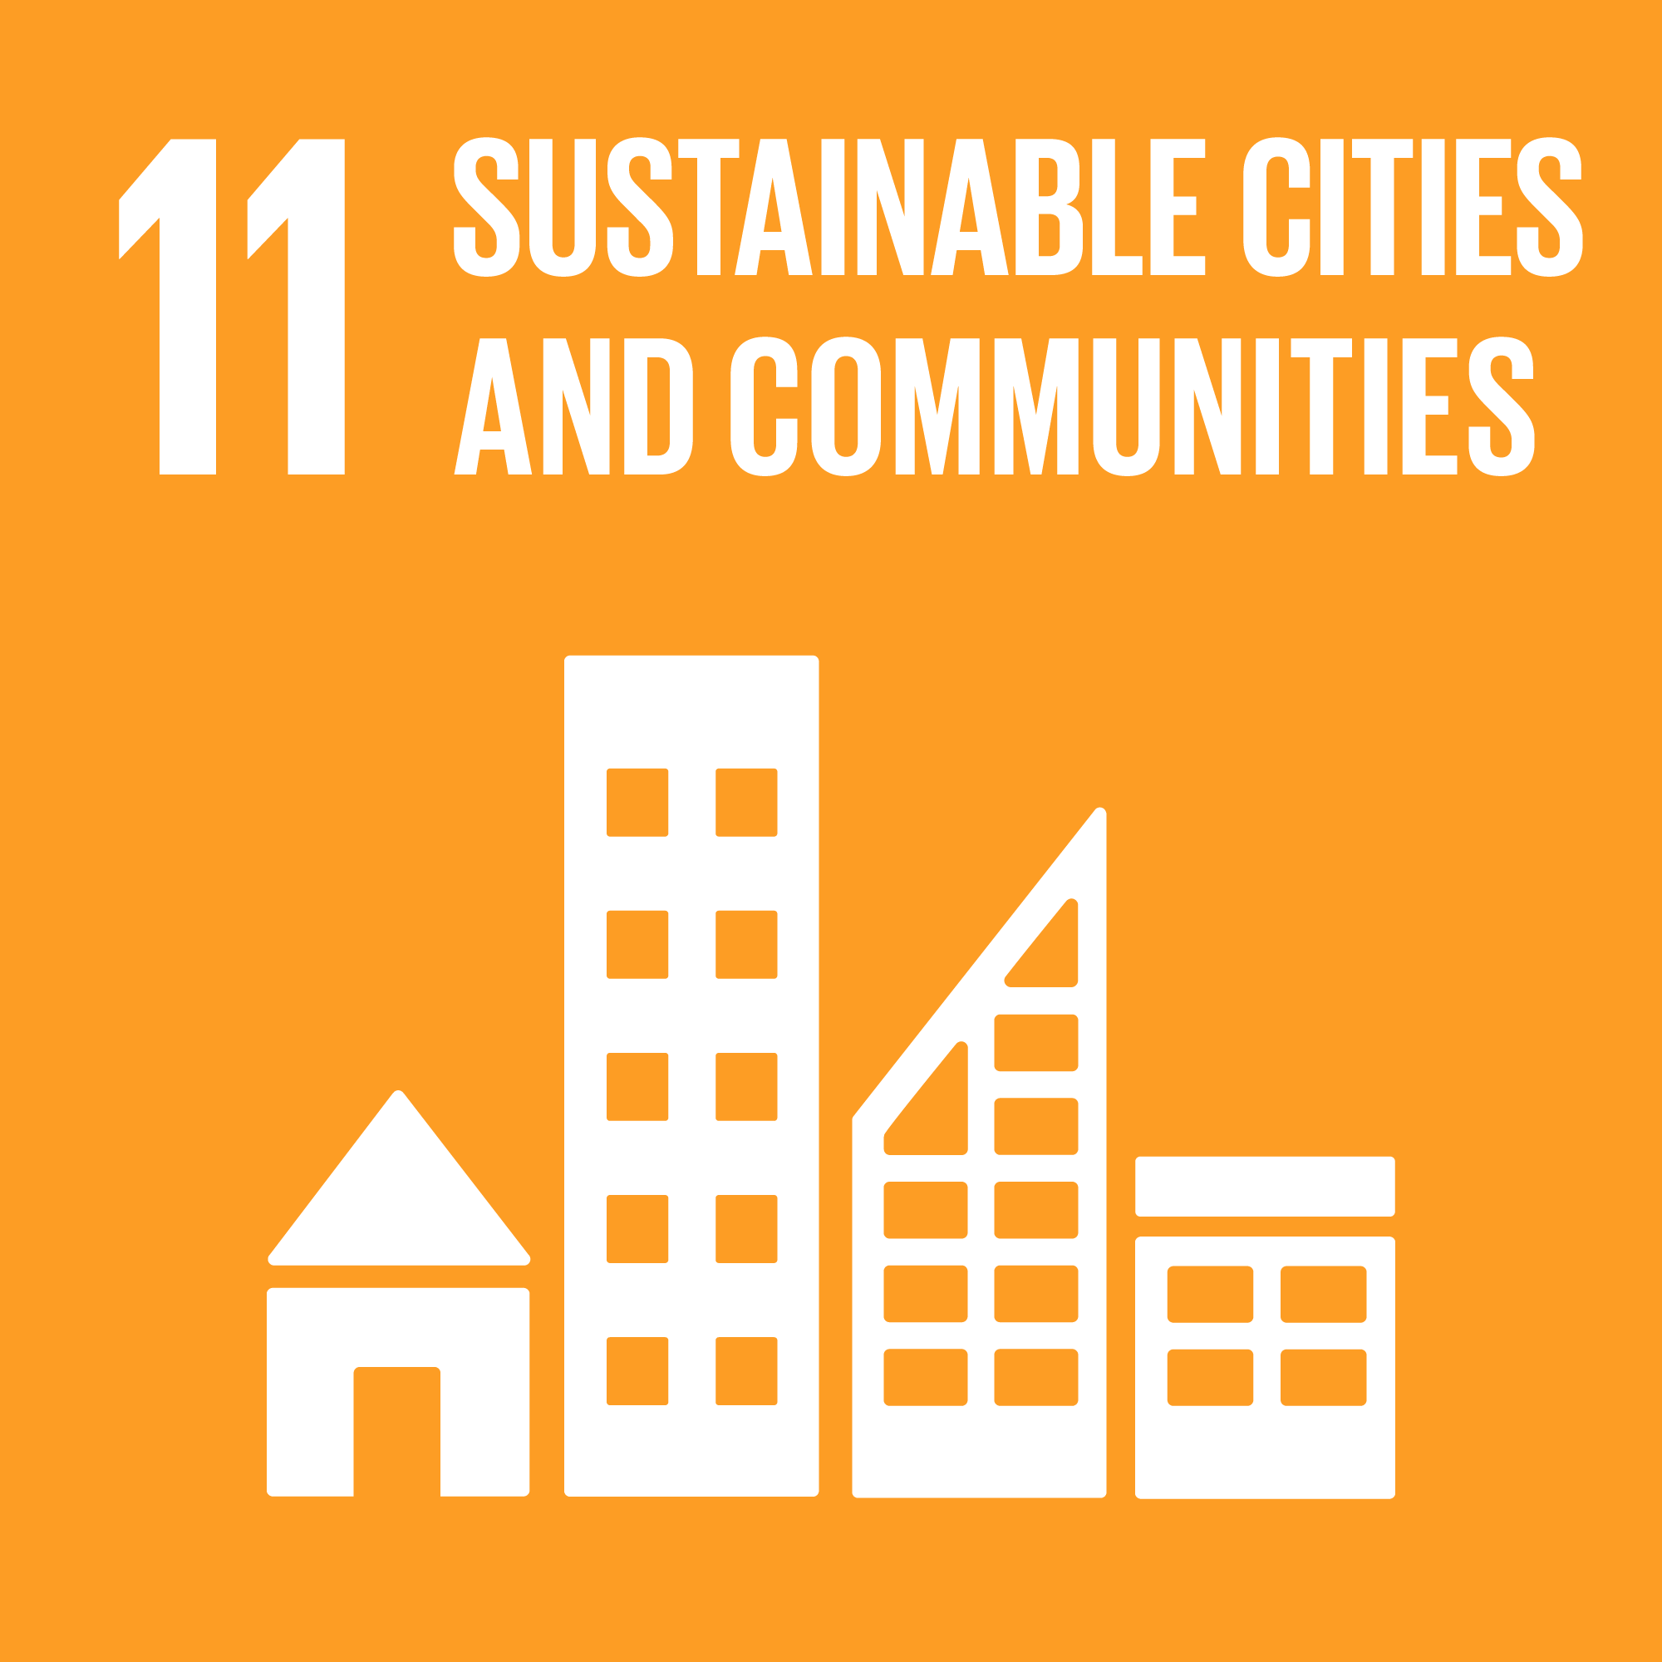
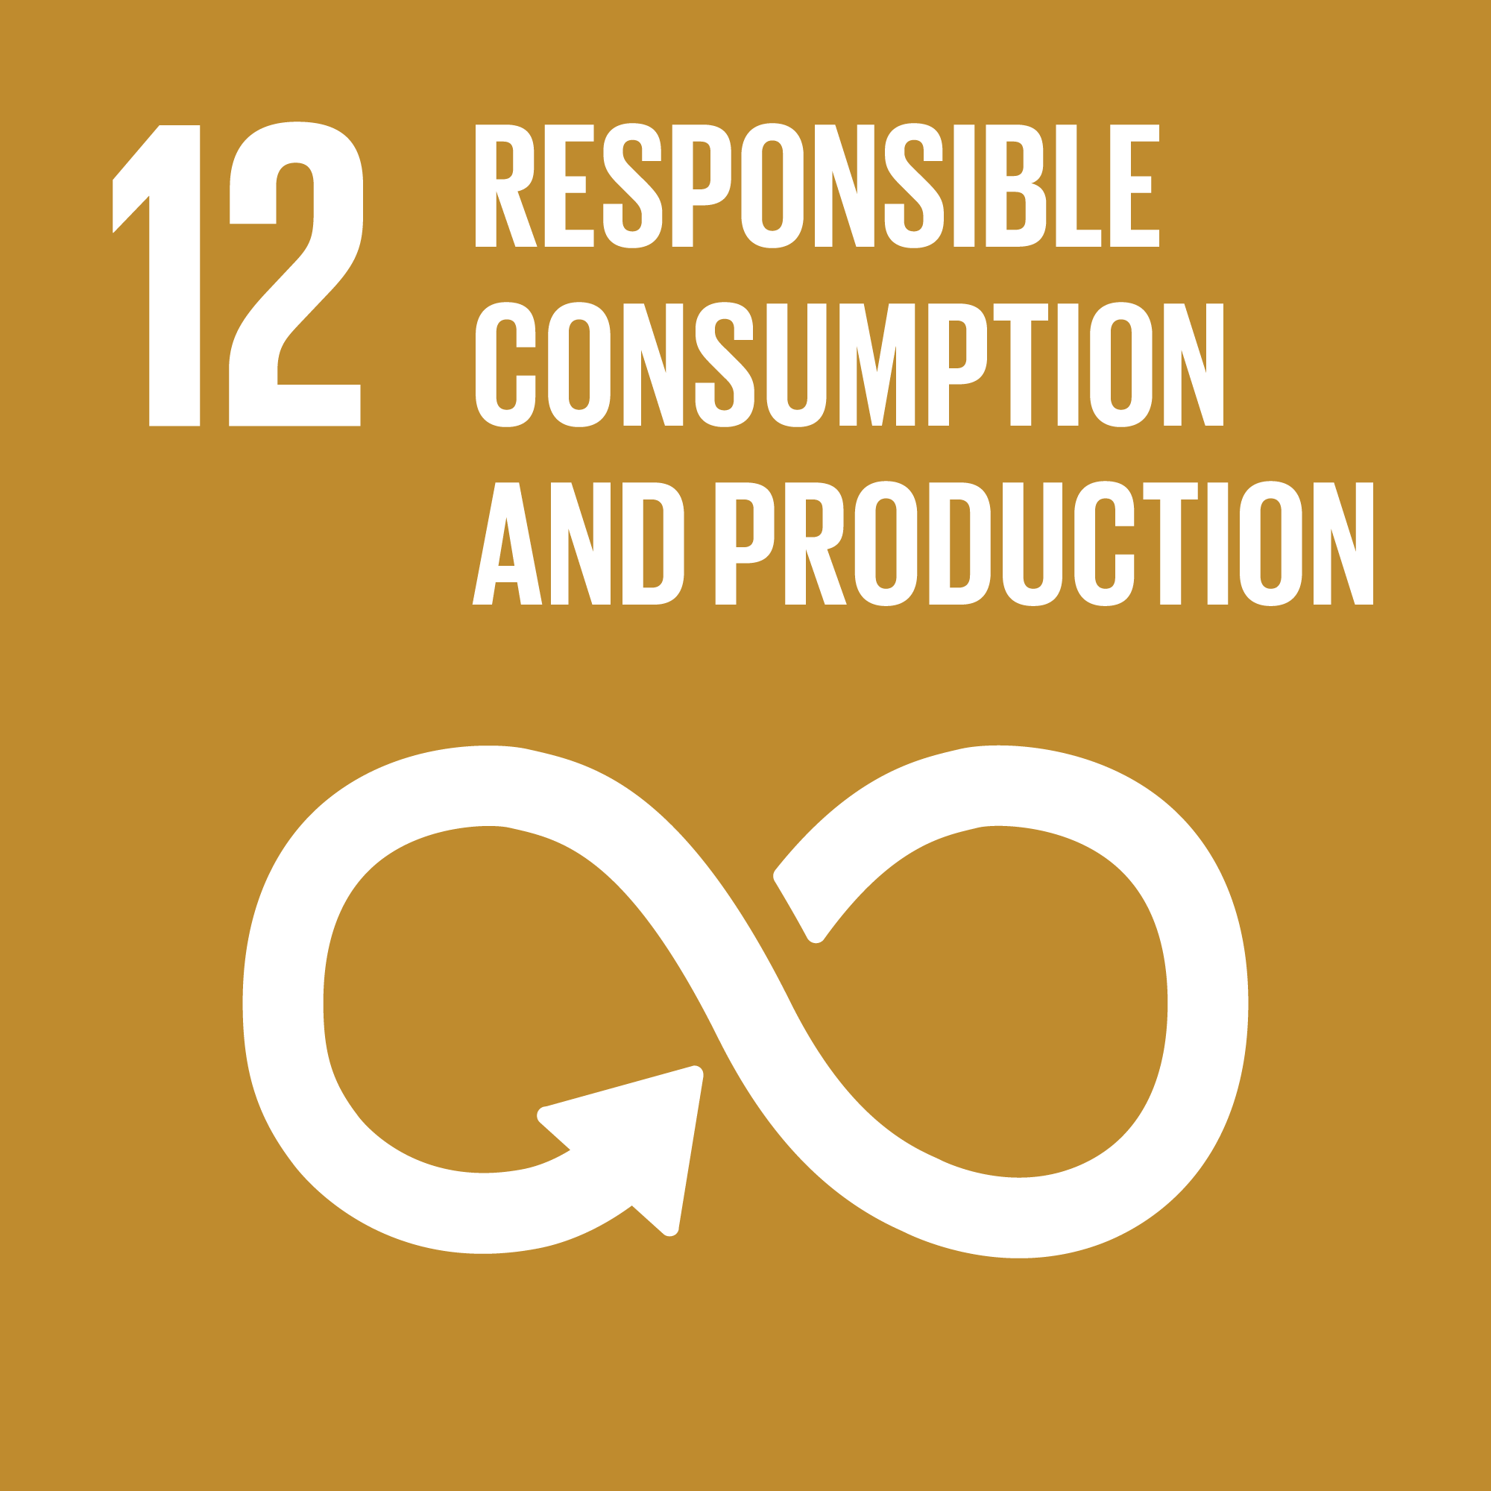
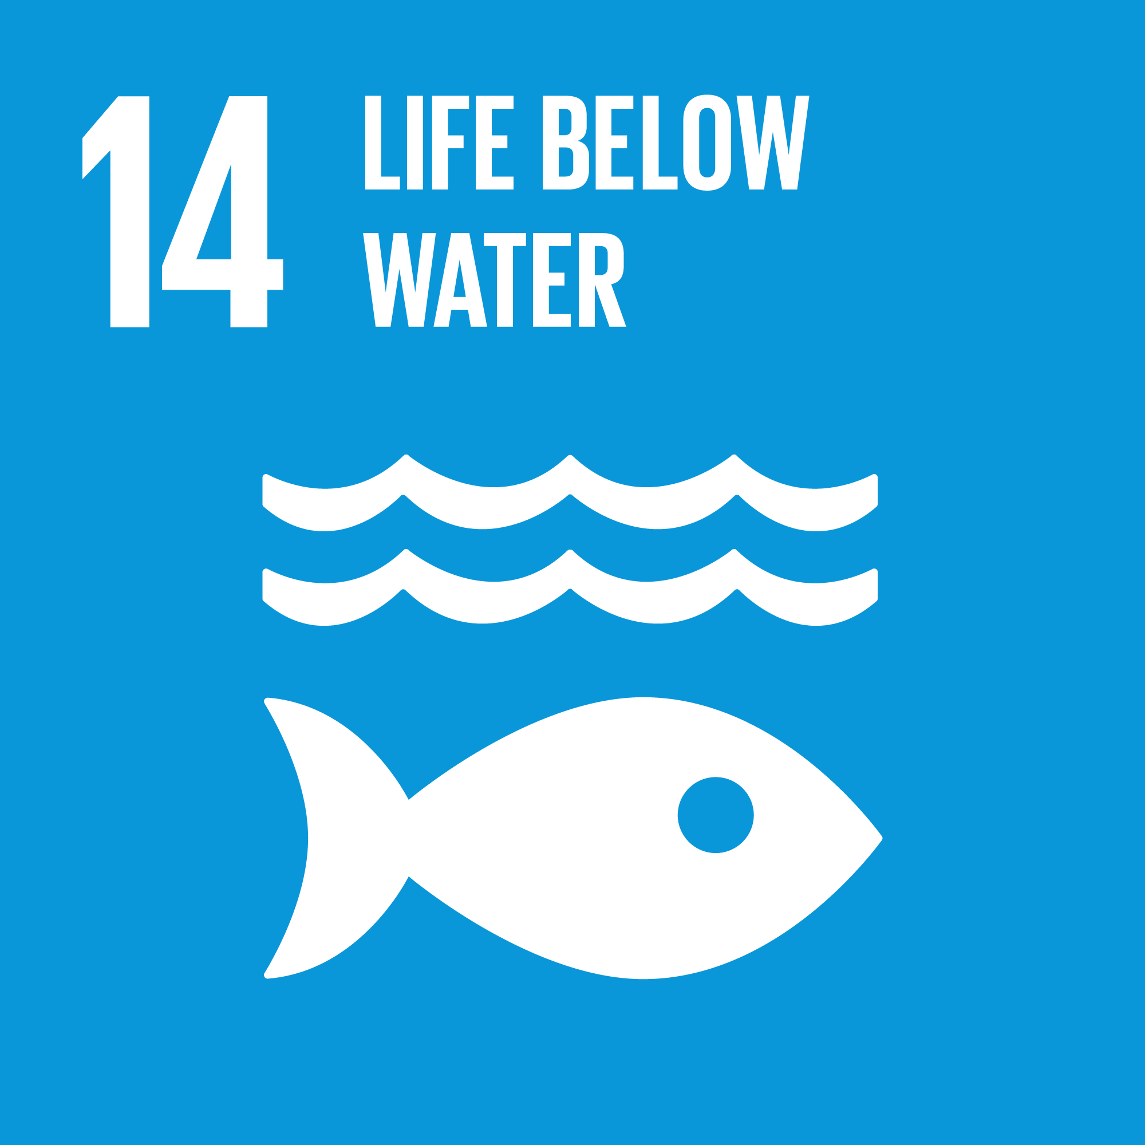
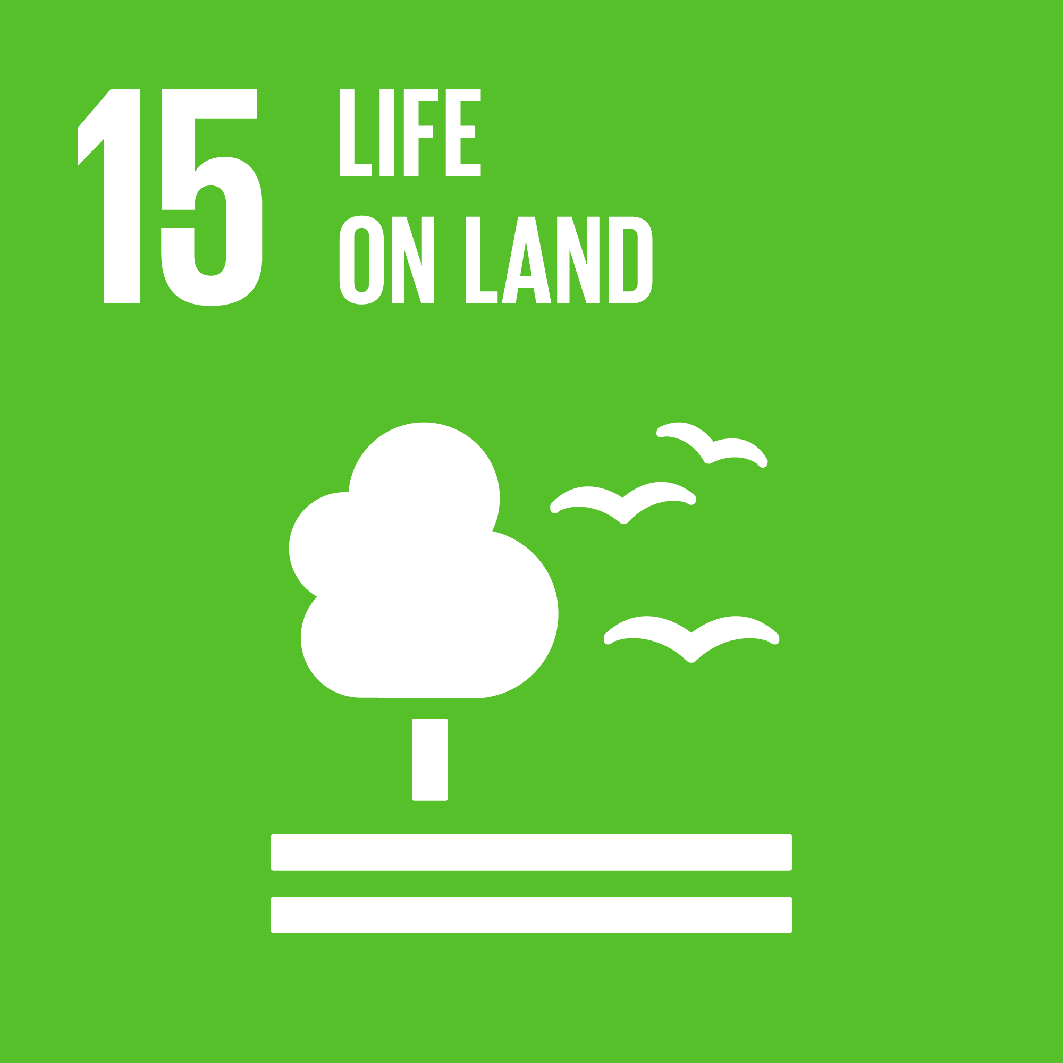
Sustainable Development Goal (SDG)
Resilient Sourcing
Safe & Sustainable Sites
Climate Change & Energy
Professional Excellence
Sustainable Profit Portfolio
Business Driven Innovation
Valuing Customer Relations
Total SGD Contribution
Low Density
Medium Density
High Density

Slide 40
GRI Content Index
The GRI Standards are the first global standards for sustainability reporting. They feature a modular, interrelated structure, and represent the global best practice for reporting on a range of economic, environmental and social impacts.
GRI 102 : General disclosures 2016 | Organization Profile
 | 102-1 Name of the Organization
 | 102-2 Activities, brands, products and services
 | 102-5 Ownership and Legal forms
 | 102-8 Information on employees and other workers
 | 102-13 Membership of association
 | Strategy
 | 102 –14 Statement from senior decision maker
GRI 103: Management Approach | Sustainable Profile, Climate Change, Water
 | 103-1 Explanation of material topic and its boundaries
 | 103-2 Management approach and its components
 | 103-5 Evaluation of management approach

Slide 41
GRI Content Index (Cont.)
The GRI Standards are the first global standards for sustainability reporting. They feature a modular, interrelated structure, and represent the global best practice for reporting on a range of economic, environmental and social impacts.
GRI 308: Suppliers Environment Assessment 2016 | Supply Chain Responsibility
 | 308-1 New Suppliers
 | 308-2 Negative environmental impacts
GRI 414: Suppliers Social Assessment 2016 | 414-1 New suppliers that were screened using social
 | 414-2 Negative social impacts
GRI 302: Energy 2016 | Energy & Climate Change
 | 302-1 Energy consumption within the organization
 | 302-2 Energy intensity
 | 302-4 Reduction of energy consumption

